Slide 1
Kepler API Design
A Recommendation Engine
Gene Olafsen

Slide 2
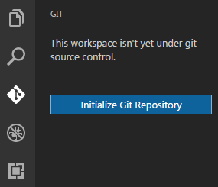
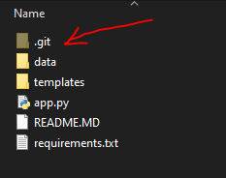
Start with source files locally
Click on “Initialize Git Repository” button. This will create a local .git folder in the local folder. This .git folder is the folder which does the magic and keep each and every detail about local branches, remote branches, local check-ins, log history and every other information which is required from version control perspective.
Once the repository is initialized the complete folder where the Git has been initialized would start to be tracked.

Slide 3
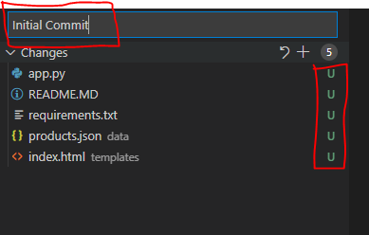
a

Slide 4
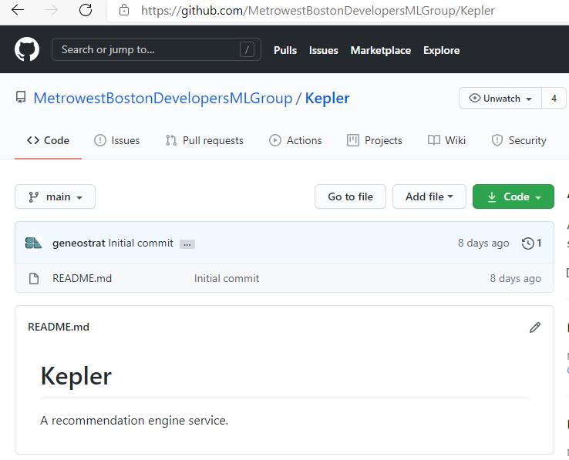

a

Slide 5
PS C:\git\Kepler> git remote add origin https://github.com/MetrowestBostonDevelopersMLGroup/kepler.git
PS C:\git\Kepler> git branch -M main
PS C:\git\Kepler> git push -u origin main
error: src refspec main does not match any
error: failed to push some refs to 'https://github.com/MetrowestBostonDevelopersMLGroup/kepler.git'
PS C:\git\Kepler> git add .
warning: LF will be replaced by CRLF in README.MD.
The file will have its original line endings in your working directory
PS C:\git\Kepler> git commit -m "initial project push"
[main (root-commit) 86a8b0d] initial project push
5 files changed, 661 insertions(+)
create mode 100644 README.MD
create mode 100644 app.py
create mode 100644 data/products.json
create mode 100644 requirements.txt
create mode 100644 templates/index.html
PS C:\git\Kepler> git push -u origin main
Enumerating objects: 9, done.
Counting objects: 100% (9/9), done.
Delta compression using up to 4 threads
Compressing objects: 100% (6/6), done.
Writing objects: 100% (9/9), 2.71 KiB | 1.36 MiB/s, done.
Total 9 (delta 0), reused 0 (delta 0), pack-reused 0
To https://github.com/MetrowestBostonDevelopersMLGroup/kepler.git
* [new branch] main -> main
Branch 'main' set up to track remote branch 'main' from 'origin'.
PS C:\git\Kepler>

Slide 6
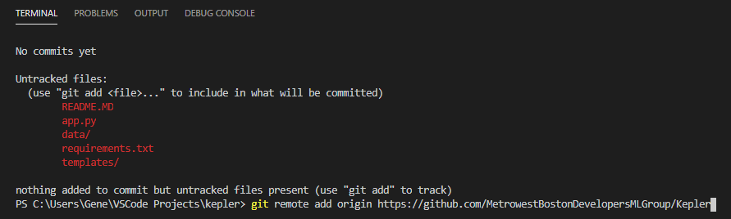
Associate with repo

Slide 7
Add changes
Add changes with the checkmark
Ctrl+Enter
git push origin -u main

Slide 8
Load
Endpoint is provided to load data file(s).
Currently the service loads the information into memory. The Docker image definition can easily be modified to include a SQL or No-SQL database server.

Slide 9
Describe
Source columns must be 'described' so that the recommendation engine can extract data for processing.
Most columns are 'scaler' types: Int, Bool, Float
Other data formats are more involved. Consider this JSON field:
[{"id": 12, "name": "Adventure"}, {"id": 14, "name": "Fantasy"}, {"id": 28, "name": "Action"}]

Slide 10
Transform
Transform the information into a format that is suitable for recommendations:
Sparse Matrix
Bag of Words
Tf-Idf Vectorizer (Term Frequency-Inverse Document Frequency)
Cosine similarity

Slide 11
Recommend

Slide 12






Session State
Mortgage Providers
Recommendation
Engine
Movies
Books

Slide 13

Session Conversation
1. Obtain a session token
Recommendation Engine
2+. Provide the session token
With every subsequent call you
Make with the service.

Slide 14
Current Endpoints
@app.route("/loadusmoviesconfig")
Executes a recommendation using configuration.
@app.route("/loadsampleconfig")
Executes the parsing of a sample configuration.
@app.route('/upload', methods=['GET', 'POST'])
Uploads a data file to the Docker image

Slide 15
Audit
http://127.0.0.1:5000/loadusmoviesconfig
[
{ "code": 0, "message": "Start audit.", "level": "Info", "extra": "" },
{ "code": 5021, "message": "Working column property is missing the extract-element attribute for this JSON define column.", "level": "Error", "extra": "crew" },
{ "code": 2007, "message": "Working column section JSON column missing item-count attribute. The entire column contents will be extracted by default.", "level": "Warning", "extra": "crew" }
]
127.0.0.1:5000/loadsampleconfig
[ { "code": 0, "message": "Start audit.", "level": "Info", "extra": "" },
{ "code": 5000, "message": "This datafile has not been uploaded.", "level": "Error", "extra": "one.csv" },
{ "code": 5014, "message": "Analyze section missing vectorize collection.", "level": "Error", "extra": "" },
{ "code": 5024, "message": "The analyze section is missing the sparse-stack collection: ", "level": "Error", "extra": "" },
{ "code": 5029, "message": "The analyze section is missing the metrics section.", "level": "Error", "extra": "" },
{ "code": 5031, "message": "The configuration file is missing a recommend section.", "level": "Error", "extra": "" },
{ "code": 5000, "message": "This datafile has not been uploaded.", "level": "Error", "extra": "one.csv" } ]

Slide 16
Configuration
Files
Transform
Analyze
Recommend

Slide 17
Current Endpoints
@app.route("/load")
Loads and parses the movie db.
@app.route("/transform")
Transforms the movie db.
@app.route("/recommend")
Recommends movies 'like' Alien.
@app.route("/all")
Performs /load, /transform and /recommend - all in one step

Slide 18
Files Section
Associate with an uploaded data file.
Identify 'working columns'
Describe 'working column' types- JSON
Specify the columns to:
Drop
Rename
Combine

Slide 19
na-filter
I want to focus on one particular argument: na_filter, which defaults to True and controls how pandas parses null values in the .csv file. Recently, I had been working on some projects where I had it set to na_filter=False, which led to unexpected errors in my code. Debugging the issues led to a better understanding of pd.read_csv and especially the na_filter.
When you call pd.read_csv on a .csv file, the na_filter argument looks for values in the file and identifies any that are likely to be NaN, such as blank cells or various iterations of “NA” (“N/A”, “NA”, “NaN”, etc. See the documentation for details). For the corresponding value in the data frame, it places a NaN value.
This is obviously quite useful, and is the behavior we would typically want.
Why would we want to set it to na_filter=False? One reason is that if we already know our data has no NAs and the file is very large, this method can be faster. Another reason is that you may want to keep strings like “NA” based on your use case. For example, if “NA” is used as shorthand for North America.
HOWEVER a word of caution: If you use na_filter=False and there are NA values in your .csv file, they will appear as blank in your dataframe, but will be invisible to null functions.

Slide 20
Files
"files" : [
{
"filename" : "tmdb_5000_credits.csv",
"na-filter": true,
"workingColumns": [
{
"header" : "movie_id",
"is-json" : false
},
{
"header" : "title",
"is-json" : false
},
{
"header" : "cast",
"is-json" : true,
"extract-element" : "name",
"item-count": 3
},
{
"header" : "crew",
"is-json" : true
}
],
"drop": [],
"rename" : [{"movie_id": "id"}],
"combineColumns" : []
},

Slide 21
Files 2
{
"filename" : "tmdb_5000_movies.csv",
"na-filter": false,
"workingColumns": [
{
"header" : "id",
"is-json" : false
},
{
"header" : "genres",
"is-json" : true,
"extract-element" : "name",
"item-count": 3
},
{
"header" : "overview",
"is-json" : false
}
],
"drop": ["tagline", "status", "homepage", "keywords","crew","vote_count", "vote_average", "tagline", "spoken_languages", "runtime", "popularity", "production_companies", "budget", "production_countries", "release_date", "revenue", "title_y", "original_language"],
"rename" : [],
"combineColumns" : [
{
"combine-header": "combine",
"column1" : "cast",
"column2" : "genres",
"item-count": 3,
"drop-source-columns": true
}
]
}
The 'Drop' operation may not be necessary as any columns that are not 'working' columns are dropped.
The combine operation is specifying a column named 'cast' that is not part of this data file!

Slide 22
Transform Overview
Primarily used (at this point) to merge data files.
I see this stage providing the ability to perform actions across data files.

Slide 23
Transform
"transform" : {
"merge": {"from-filename": "tmdb_5000_credits.csv",
"to-filename":"tmdb_5000_movies.csv",
"on-column":"id"}
},

Slide 24
Analyze Overview
This is where the machine learning operations are defined.
Vectorizers
Sparse matrix manipulations
Similarity calculations

Slide 25
Analyze
"analyze" : {
"vectorizers" : [
{ "id": "countVec", "vectorizer": "count", "stop-words":"english", "column": "combine"},
{ "id": "tfidfVec", "vectorizer": "tfidf", "stop-words":"english", "column": "overview"}
],
"sparse-stack": [
{
"id" : "sparse",
"stack-type" : "hstack",
"format" : "csr",
"vectorized-matrix-ids" : ["countVec","tfidfVec"]
}
],
"metrics": {
"similarity" : "cosine"
}
},
Intent to support:
API Reference — scikit-learn 0.24.1 documentation (scikit-learn.org)

Slide 26
Recommend Overview
Associating a request with a working column.
Response formatting.

Slide 27
Recommend
"recommend" : {
"request-column" : "title",
"response-count" : 20,
"response-columns" : [
{"source": "id", "output":"Movie_ID" },
{"source":"title", "output":"Name"},
{"source":"genres","output":"Genres"}
]
}

Slide 28
Configuration Roadmap
The analyze section of the configuration may be end up being a 'pipeline' with separate processing stages.
Data-types may be useful to be defined for each of the working columns.

